Slide 1

DRAFT
FOR DISCUSSION ONLY
PwC Retail Industry e-business
BroadVision Initiative Planning Session
Retail Storyboard Discussion Document
© 1999, PricewaterhouseCoopers L.L.P.

Slide 2
PwC’s Retail Industry Practice has these goals/objectives for our Broadvision Initiative
One Effort, Worldwide Usability
  Use at the Zone and at Retail Solution Centre
  Subsequently provide a jump start for client projects
    Define client project methodologies including milestones, deliverables, toolsets
    Use as starting point for further template development
Demonstrate Industry Expertise - impact of B-to-C on brick-and-mortar
  Storyboard should provide opportunities to demonstrate our knowledge of industry issues and our “.com in a box” solution
  Targeting E-tailers who are Retailers (seeking solutions to e-tail and to multi-channel challenges)
Build in opportunity to expand the story to include other solutions in the future
  Initially necessary for RSC (SAP Retail integration)
  Great potential for more (e.g., B-to-B, Customer Information, etc.)

Slide 3
Our efforts in the Broadvision initiative must highlight our understanding of issues and our proposed solution for a retailer’s key challenges:
Global Concerns
  Language, Currency, Import/Export, Tax
Multi-Channel Complexity
  At home internet shoppers and in-store kiosk customers
  Complexity inherent in multi-channel can be managed/simplified by appropriate technologies like Broadvision
B-to-C
  There are also be B-to-B applications, but our initial focus is B-to-C
Personalization
  One of our key differentiators will be using BVSN capabilities to know the customer upon entry

Slide 4
Relevant Messages from our overall Retail E-Business Strategy

Slide 5
The Retail E-Business Evolution (Five Box Model)
Restructuring the value chain to create “many-to-many” relationships, new value propositions & new business models
Industry
Transformation
Future
Phases
Companies entering new industry sectors and competing outside of their core business areas
Convergence
Current
Phases
Value Chain
Integration
Connections with trading partners & process changes across the value chain (buy side or B2B)
Degree of change to business model
Channel Enhancement
Enhancing current channels and adding new channels to market (sell side or B2C)
Enterprise Connectivity
Internet technology enabled process, systems & organizational change & getting the organization connected
Role of E-Business

Slide 6
In the Direct-to-Consumer arena, we provide retailers with a “dotcom-in-a-box” offer
Strategy / Organization
Operational Effectiveness
Technology Solutions
  Package Implementation / Integration
    E-Commerce Packages (e.g. Broadvision, Open Market, Intershop, Vignette, ATG, BlueMartini, Net.Commerce)
    Point Solutions (e.g. Net Perceptions, ClearCommerce, )
    ERP (e.g. mySAP.com)
  Ongoing Application Management / Site Hosting
Tax, Legal and Security

Slide 7
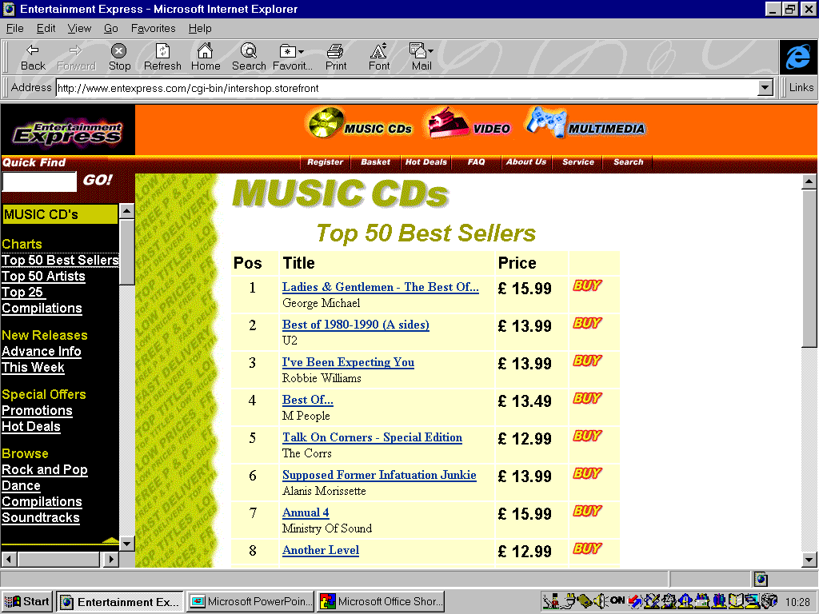

Direct-to-Consumer Business Architecture
Business Management
eCommerce Architecture
Content Management
Storefront Presentation
Merchandise Planning
Digital Asset Management
Content Workflow
Version Control
Storefront Catalogue
Site Management
Open-to-Buy
Replenishment / Allocation
Content
Staging
Stored Data
Security
Configurator
Affiliate
sales
Product Development
Distribution /
Logistics
Buying / PO Management
Inventory Management
Customer Relationship Management
Auctions
Storefront Formatting
Web (HTML)
Email
XML
WAP
SMS
Proprietary
Site analysis / reporting
Collaborative Filtering
Promotions / Events Management
Customer
Master Data
Performance Monitoring
Price Management
Customer Self-Service
PC
Personalisation
Analytical
Engine
Customer
Loyalty
Cell Phone
Promo / Event Management
Marketing
Community
iTV
Commerce Transaction Processing
Site Access
Security
PDA
Order
Processing
Security
Order Confirmation
Shipping Calculation
Customer Order
Electronic Marketing Automation
Kiosk
Customer Data Warehouse
Merchandise Data Warehouse
Payment Authorisation
Tax Calculation
Inventory Check
Telephone
HR
Finance
Fulfillment
Call Center
Payroll
(Tangible Goods)
(Digital Goods)
Warehouse Management
Transport Management
Electronic Fulfilment
Corporate
Security
Settlement
Distribution Planning
Returns Management

Slide 8






A High Level View of Leading E-Commerce Vendors
(BroadVision focus: personalized storefront presentation)
Business Management
eCommerce Architecture
Content Management
Storefront Presentation
Customer Relationship Management
PC
Cell Phone
iTV
Commerce Transaction Processing
PDA
Kiosk
Telephone
Fulfillment
Fulfilment
Call Center
(Tangible Goods)
(Digital Goods)

Slide 9
Retail Storyboards

Slide 10
T & K Company Profile and Web site Features
T & K is an international mass merchandiser with stores and warehouses based in North America, the United Kingdom, and Europe . The company has decided to develop new distribution channels and will pursue the development of a web-site offering customers around the world the opportunity to enjoy the same personalized shopping experience they find in T&K stores no matter they are. The Website will be based on the following product offering and features:
Product Offering
  Apparel and Accessories
  Health and Beauty
  Food
  Housewares
  Home Office
Personalization & CRM
  Support Regional Home Pages for an International retailer
  Support customer sign-up, customer profiling, and profile updates
  Provide customers with a personalized shopping experience (appropriate language, currency, shopping/ fulfillment style, proactively provide information about appropriate lifestyle/interest promotions etc.) through the analysis of customer profiles and web-site usage tacking.
  Obtain customer feedback; or conduct customer polls

Slide 11
T & K Company Profile
Shopping Experience
  Allow extensive buying-on-website capability (shopping cart; save shopping cart; replenishment orders; different ship to /bill to; multiple ship to; gifts; personalized/customized products; buy something for someone off their wish list; create wish lists)
  Supply customer with various means of obtaining help(chat-style help ; self service help; phone help while online, etc. )
  Provide extensive gift purchasing assistance: registry/wish list; ability to identify people who may have access to their lists?; reminders about time-to-make gift purchases, etc.
  Support shopping-related activities: check on order status; pay a credit card balance (or customer wants to get a credit card); more details provide information about a product (reviews, recalls, special product-related events)
  Support online inventory checking of local stores. Allow a customer to shop on-line and pick up merchandise locally.
  Support online inventory checking of local stores. Allow a customer to shop on-line and pick up merchandise locally.
Corporate Information
  Provide company information(shareholder information; employment opportunities, store hours…)
  Provide alternative channel information including store locations and hours; special store promotions/events; item availability at store locations; pick up product at store locations; store layouts (if accessing from a store kiosk)
  Press Releases
  Employment Opportunities

Slide 12
Customer Profiles
Customer 1 is an unregistered customer who comes to the website from a shopping serivce site looking for a specific item. He is in a hurry to shop, is looking for price / value, and is not willing to spend the time to divulge profile information. He shops for the specific items he is looking for places them in his shopping basket and proceeds to checkout. During the checkout process, Customer 1 becomes a registered user providing name, shipping and billing addresses, and credit card information. BroadVision stores tracking and purchasing data, and builds the basic customer profile.
Customer 2 is a returning customer who has a basic profile that is based only on a previous purchase. As a satisfied customer she is willing to provide for information about herself, and begins to fill out a detailed profile on her subsequent visit to the T&K website. She identifies her perferred shopping categories, personal information, hobbies and interests, and indicates she is interested in receiving e-mail.
Customer 3 is Customer 2’s teenage daughter, she creates a profile indicating her prefferences. Additionally she creates a Wish List, where she indicates family members and friends who she would like to send gift ideas to.

Slide 13
Storyboard 1: An unregistered user visits the T&K.com for the first time and completes a simple sales transaction
Features | Personalization
By selecting a country the user will determine what language text will be displayed in, and what currency they will be paying for merchandise in. | At this point, a cookie is placed on the machine to automaticlly direct the user to the apporpriate regional home page on a subsequent visit. A user can select an alternate choice from the regional home page, their selection become the default.
Home page template displays appropriate language content. Template contains standard rules designed to display current general promotions, offer general informatoion, entice the customer to register, and direct them to the shopping pages | New site visitor receives standard home page elements. The website does not recognize them and asks the customer to take the time to register
The customer declines registration and procedes to the shopping areas to browse for merchandise. The product page templates display current promotions based on the default rules for a category whene the user is unkown | Personal shopper offers advice for the
Splash Page
Customer selects a region from which they are shopping (US,UK, Europe)
Home Page
Customer is directed to the US Regional Homepage, the customer can select from product categories, search for specific items, view current specials, see corporate info, etc.
Product Page
Customer select a product category to shop in

Slide 14
This storyboard describes the experience of an unregistered user who comes to the website for the first time, shops, selects merchandise for purchase and completes an online sales transaction
Splash Page
Customer selects a region from which they are shopping (US,UK, Europe)
Home Page
Customer is directed to the US Regional Homepage, and begins shopping
Category Page
Customer is directed to a product category page
Product Detail Page
Customer can view detailed information about the product
Shopping Basket
Customer places products in shopping basket
Checkout Process
Customer provides name and payment information and confirms order

Slide 15
This storyboard describes the experience of an internet customer who returns to the website, registers for personalized home page, fills out a customer profile, and accesses a personalized home page

Slide 16
This storyboard describes the experience of an internet customer who comes to the website for the first time, shops, selects merchandise for purchase and completes a sales transcation

Slide 17
This storyboard describes the experience of an internet customer who comes to the website for the first time, shops, selects merchandise for purchase and completes a sales transcation

Slide 18
This storyboard describes the experience of an internet customer who comes to the website for the first time, shops, selects merchandise for purchase and completes a sales transaction

Slide 19
I. Home Page
Client logo
Provide a more detailed description of each of the tab/button options
Client information with the following tabs/button
Description of the customer experience:
Allow Customer to see information about the company including
  store locations
  catalog requests
  customer service phone numbers
  about the company
  employment opportunities
  ways to shop
Allow/Encourage customer to login or to join
Customer svce
store locations
catalog request
Login space for name and password
Value to the customer
Easy to understand
Communicate general messages from client to customers
Enabling applications/features of BroadVision:
System and Data requirements:
Initial set up should be the T&K home page
Value to the client
This page (or at least left panel) may need to be easily customizable so that clients may see broad variation in how it is used based upon the manner in which they wish to be perceived by the customer

Slide 20
I. Home Page
Client logo
Provide a more detailed description of each of the tab/button options
Client information with the following tabs/button
Description of the customer experience:
Allow Customer to see information about the company including
  store locations
  catalog requests
  customer service phone numbers
  about the company
  employment opportunities
  ways to shop
Allow/Encourage customer to login or to join
Customer svce
store locations
catalog request
Login space for name and password
Value to the customer
Easy to understand
Communicate general messages from client to customers
Enabling applications/features of BroadVision:
System and Data requirements:
Initial set up should be the T&K home page
Value to the client
This page (or at least left panel) may need to be easily customizable so that clients may see broad variation in how it is used based upon the manner in which they wish to be perceived by the customer

Slide 21
II. Customer registers or updates profile
Client logo
Customer
specific
navigation
layout
Client information with the following tabs/button
Description of the customer experience:
Name
Address
email address
day and evening phone
gender
e-mail application
Do you get catalogs
Do you shop catalogs
Do you shop stores
Do you use kiosks
Do you buy for yourself and or for others
Same as home page
High level illustration of what’s on the screen
Name/Password
Address
email address
day & eve phone
gender
Do you get our catalogs?
Do you shop our catalog?
Do you shop our stores?
Do you use our kiosks?
For whom do you buy?
Value to the customer
Will receive relevant information when they get online
Enabling applications/features of BroadVision:
System and Data requirements:
System should analyze and accept name/password and provide a pop up that user is signed up or notified of errors...
Value to the client
Will know about the customer (PwC needs to know why each question is being asked)

Slide 22
III. Customer’s personalized access page
Client logo
Customer
specific
navigation
layout
Client information with the following tabs/button
Description of the customer experience:
Based upon type of shopper, the personalized page should be different (e.g., first time shopper who is not very familiar with the brand may have a “beginners” page; loyal store customer may have a different page)
Customer should receive notifications if others have sent a wish list for them to see
Customer should be reminded if an event they’ve requested a reminder about is coming soon
Tell customer about product of the type they’ve purchased before (a la amazon.com)
Tell customer about events that may occur near where they live
High level illustration of what’s on the screen
Value to the customer
Information received is very relevant
Enabling applications/features of BroadVision:
System and Data requirements:
Value to the client
More loyalty; higher sales

Slide 23
Client’s Corporate Information
High level illustration of what’s on the screen
Client logo
Customer
specific
navigation
layout
Client information with the following tabs/button
  Corporate information
  Employment opportunities
  Shareholder information
  Store Locations
Description of the customer experience:
Value to the customer
Enabling applications/features of BroadVision:
Systems requirements:
Value to the client

